Slide 1
Team Details
(Fill in your registered SIH details — placeholders below)
AgriEdge AI
Team Name
AGRIEDGE
Team Leader
K EEKSHITA
Offline-First · Anti-Exploitation · Edge AI
Institute / College
VELTECH UNIVERSITY
Target Event: HACK DEVENGERS 2.0
City & State
CHENNAI, INDIA
Domain: AGRICULTURAL AND RURAL DEVELOPMENT
Theme
Agriculture & Food Tech (Agri tech)
Core Tech: TFLite · Flutter · OCR · Python
Problem Statement Title
AI-powered crop disease diagnosis & farmer advisory
HACK DEVENGERS 2.0
Domain: Agritech · Edge AI · Anti-Exploitation

Slide 2
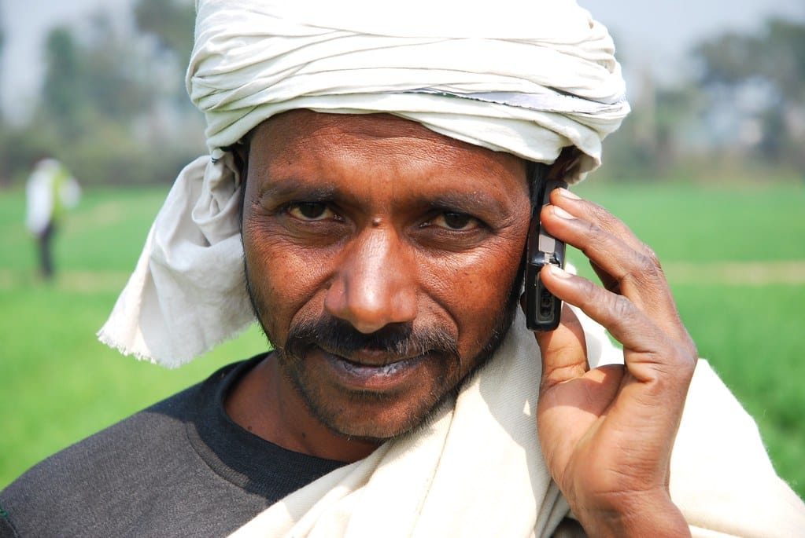
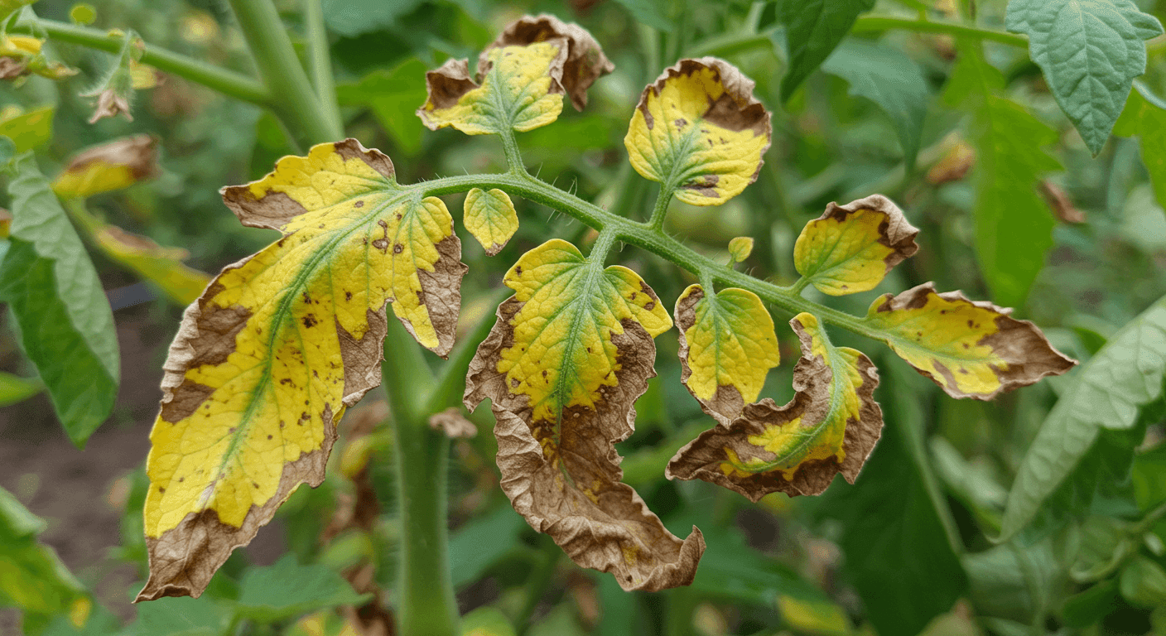
Problem Statement & Proposed Solution
AgriEdge AI — Offline-First Agri Ecosystem
[!] Problem — Ground Realities
[OK] Proposed Solution — AgriEdge AI
Current agri-diagnostic apps suffer from:
A hybrid, offline-first ecosystem that:
• Connectivity dependency — 4G/5G drop = unusable in remote fields
• Single-photo misdiagnosis — shadows, leaf moisture → wrong chemicals
• Retail exploitation — local sellers push wrong / high-margin pesticides
• No financial safety nets — PMFBY claims lack audit-ready evidence
• Buyer exploitation — opaque supply chains & middlemen drain premiums
• Adoption barrier — only 1–3 % of active Indian farmers use such apps
• Runs full diagnostic on-device — ZERO internet in the field
• Multi-modal verification: voice (local dialect) + 5–10 photos
• 4-stage fail-safe pipeline with on-device TFLite model
• OCR chemical-label scanner = Retail Scam-Shield
• Cloud-sync Crop Health Passport → buyer bidding, KVK, PMFBY
• Anti-fraud layer — live camera, EXIF, GPS geo-fencing, pHash

Slide 3
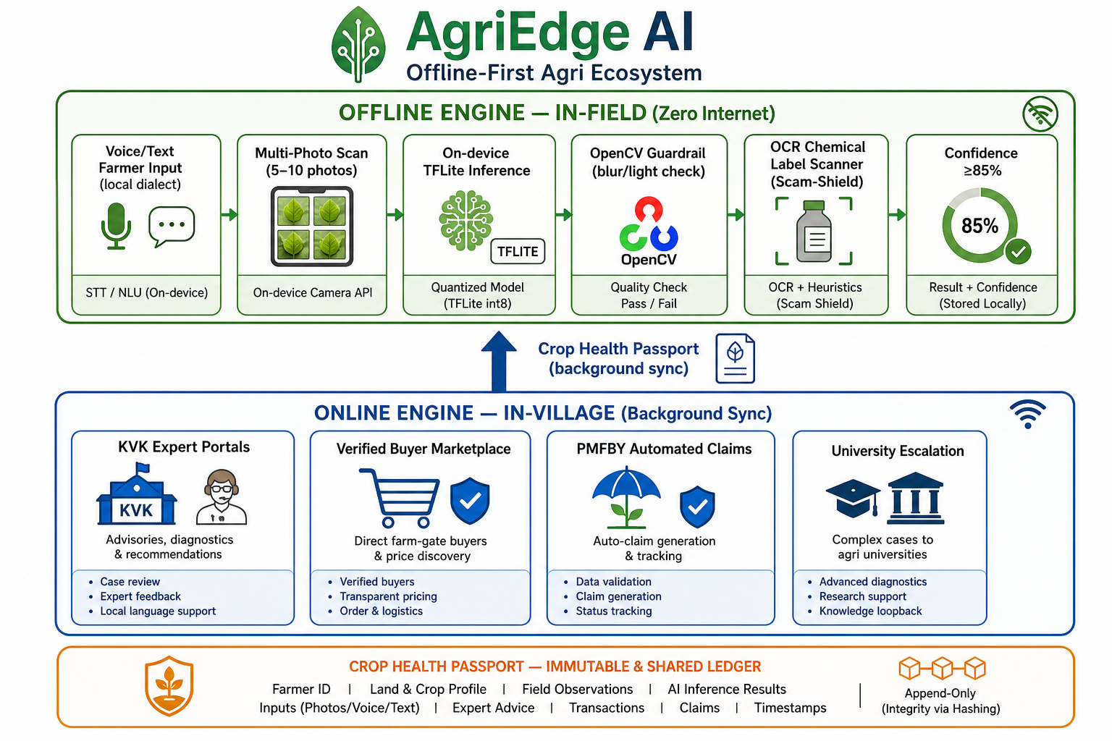
Technical Approach
Two-Mode Architecture · Offline-First · Anti-Exploitation

Slide 4
4-Stage Fail-Safe Diagnostic Pipeline
How AgriEdge AI reaches an advisory in the field
On-device · Offline · Confidence-gated · Anti-Exploitation
STAGE 1
STAGE 2
STAGE 3
STAGE 4
Farmer Intuition
Multi-Angle Scan
Rule-Based Q&A
Precision Advisory
• Voice / Text input
• Local-dialect parsing
• Extracts: weather,
• symptom onset, crop type
• 5–10 leaf photos
• OpenCV blur / light guard
• On-device TFLite inference
• Spatial averaging
• Cross-verification Qs
• Audio / icon triggers
• Confidence gate check
• ≥ 85 % threshold
• Organic-first recommendation
• Generic chemical salts if needed
• OCR label verification
• (pesticide scam-shield)
If confidence < 85 % :
Request new photos → Human-in-the-loop KVK / University escalation
→ 24 h tele-callback · 48 h on-site visit SLA
Organic-first prescriptions · Generic chemical salts only when necessary · OCR pesticide cross-check shields farmers from retail scams

Slide 5
Feasibility & Viability
Known Limitation → Engineering Mitigation
Known Limitation / Failure Mode
Engineering Mitigation Strategy
Blurry / dark field photos
OpenCV guardrail — real-time blur & lighting check
Out-of-scope / rare diseases
Auto-escalation to KVK expert portal
Internal / root-only pathogens
Voice-guided stem-discoloration & soil-dampness prompts
Large APK footprint
int-8 quantization — model kept under 15 MB
Fraudulent crop-damage claims
Live camera lock + EXIF + GPS geo-fencing + pHash
Result: a robust, deployable APK that fits low-end smartphones and works reliably in low-connectivity rural India.

Slide 6
Impact & Benefits
Measurable outcomes for farmers, buyers & government
Measurable Impact
0 %
>= 85 %
12–15 MB
10–20 %
24 h
48 h
Internet required
in field
Confidence gate
threshold
TFLite model
footprint
Price premium via
Crop Passport
KVK tele-callback
SLA
Field-officer visit
SLA
For Farmers
For Verified Buyers
For KVK / Govt (ADO)
• Shields from retail pesticide scams
• Prevents crop destruction by misdiagnosis
• 0 % internet required in the field
• Direct premium: 10–20 % via Crop Passport
• Quality-assured produce supply
• Transparent farm-gate bidding
• Cuts out traditional middlemen
• Health-clearance badge per lot
• Audit-ready PMFBY claim generation
• Expert escalation within 24 h (call) / 48 h (visit)
• Universities see real-time disease outbreaks
• Faster, evidence-based policy decisions

Slide 7
Research & References
Datasets, models & domain knowledge underpinning AgriEdge AI
Core Dataset
PlantVillage Open Dataset — labelled leaf-disease images for crops (base for transfer learning).
Why AgriEdge AI ?
Model Architectures
MobileNetV3 · EfficientNet — lightweight backbones chosen for mobile / edge inference.
• Only offline-first agritech with a multi-modal fail-safe pipeline
• Quantized TFLite = ≈ zero entry cost on any low-end smartphone
• Closes the loop: field diagnosis → market premium → insurance
• Built for India: local dialects, KVK, PMFBY, ADO workflows
• Designed BY & FOR rural India — every layer is anti-exploitation
On-device Runtime
TensorFlow Lite (.tflite, int-8 quantized to ~12–15 MB) embedded in Flutter app assets.
Image Quality
OpenCV — real-time blur / lighting guardrail for unreliable field conditions.
OCR & Anti-Scam
OCR engine + perceptual hashing (pHash) + EXIF + GPS geo-fencing for fraud prevention.
Government & Domain
KVK (Krishi Vigyan Kendra) expert network · PMFBY crop-insurance scheme · ADO Agriculture Department Officers.
Training Pipeline
Python · Google Colab · Transfer Learning (PlantVillage → MobileNetV3/EfficientNet).
Thank you !

